Slide 1
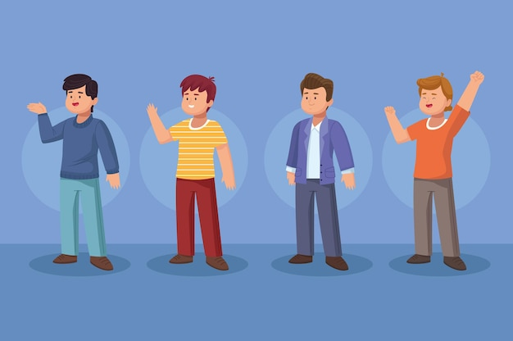
Healthify: An AI-Powered Smart Healthcare System
Mukesh Lomror
Aditya Kr. Gupta
Aditya Kanaujia
Aditya Sharma
Aditya Jaiswal
Richa Singh
CSE (AI)
KIET Group of Institutions, Ghaziabad

Slide 2
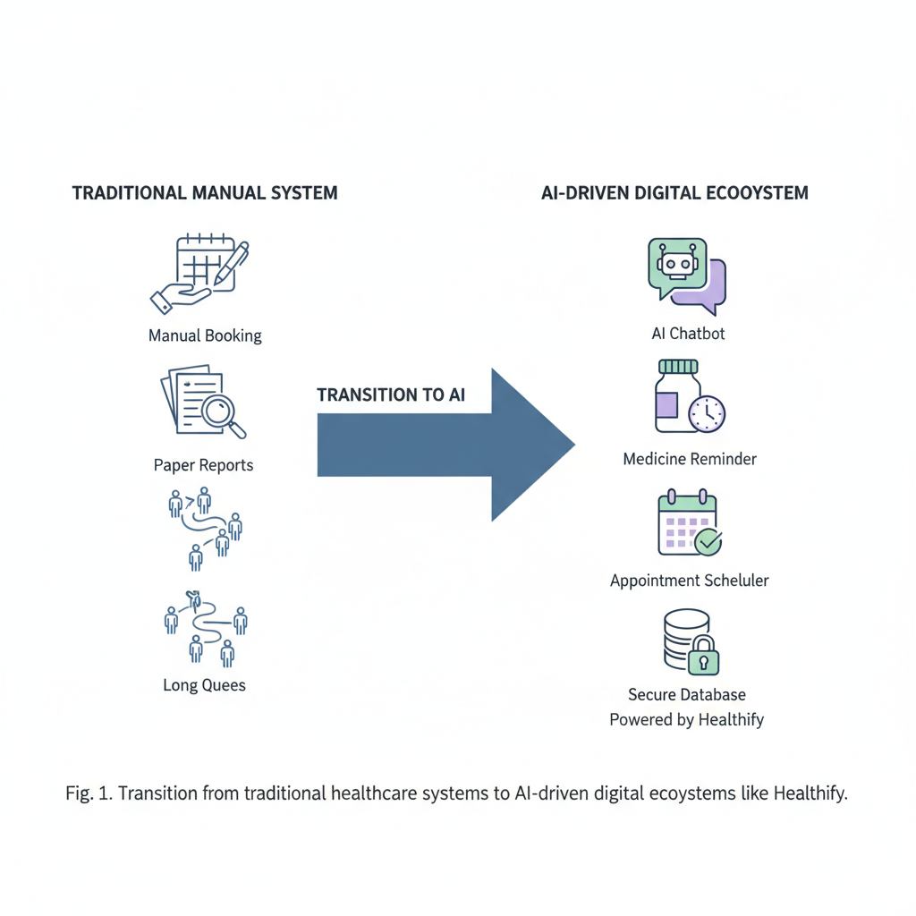
Objectives
Improve healthcare accessibility
Reduce doctor workload
Provide smart medical assistance
Automate appointment booking
Improve patient engagement

Slide 3
Key Features
AI Chatbot
Provides symptom-based consultation.
Medicine Reminder
Sends reminders for medicines.
Appointment Scheduling
Easy doctor appointment booking.
Medical Report Generator
Creates structured medical summaries.

Slide 4
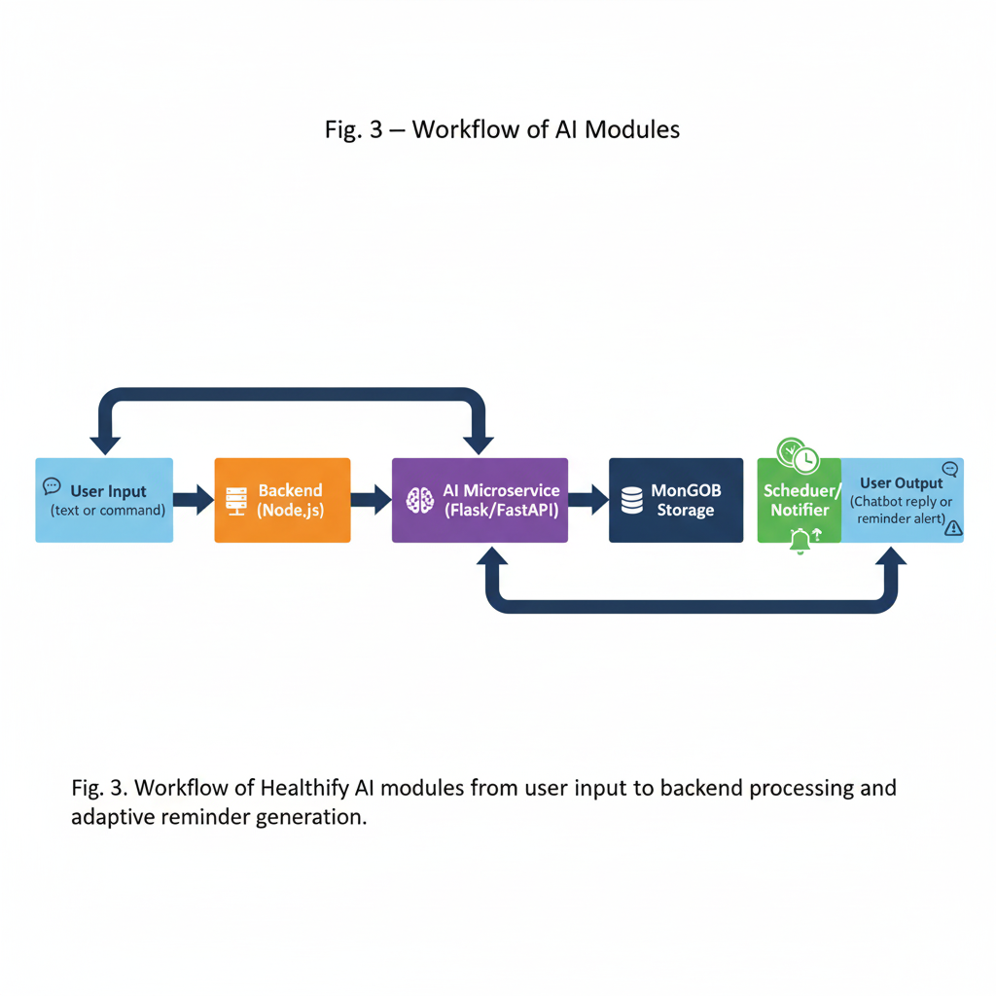
Technologies Used
Frontend: React.js
Backend: Node.js, Express.js
Database: MongoDB
AI Services: Python, Flask / FastAPI
Security: JWT Authentication, AES Encryption
Architecture: MERN Stack + AI Microservices

Slide 5
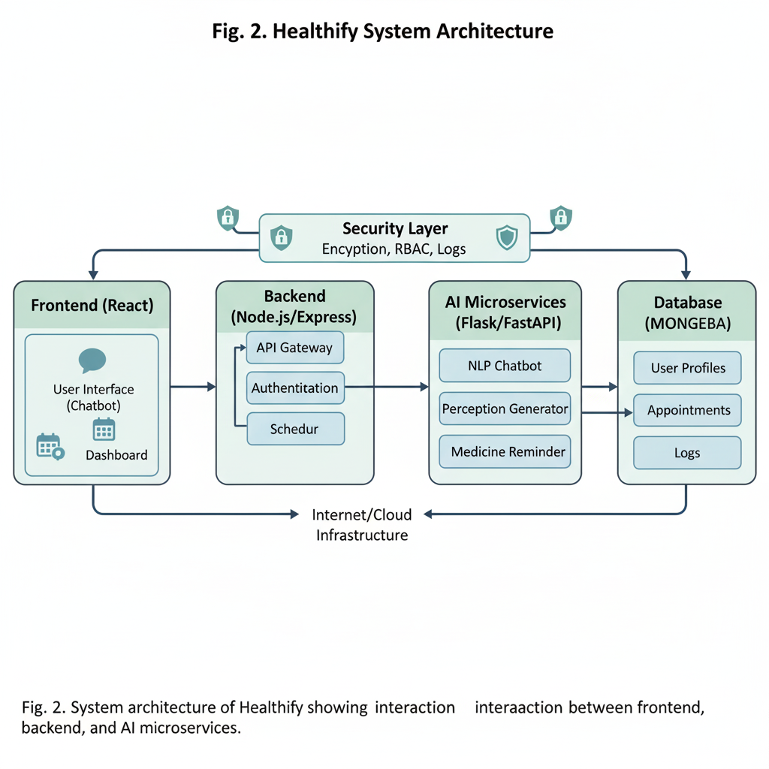
System Architecture
Healthify uses 4 layers:
Presentation Layer – User Interface (React)
Application Layer – Backend APIs (Node.js)
Processing Layer – AI Models (Python Microservices)
Data Layer – MongoDB database

Slide 6
Implementation & Results
Built using Microservices Architecture Components:
Chatbot Service
Appointment Scheduler
Medicine Reminder System
Medical Report Generator
Results:
Chatbot Accuracy: 94.6%
Reminder Accuracy: 96.3%
Response Time: <700 ms
System Uptime: 99%

Slide 7
Conclusion & Future Work
Healthify improves healthcare through AI automation.
Benefits:
Faster consultation
Automated scheduling
Better medicine adherence
Secure patient data
Future improvements:
Federated learning
Edge AI
Integration with national digital health systems
Advanced diagnosis modules

Slide 8
THANK YOU

